Slide 1
DUNGEON MASTER
fear
trembling
+
on the
blockchain
Notes:
Introductory remarks

Slide 2
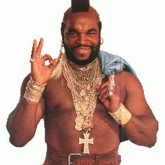

What is the Blockchain?

Slide 3
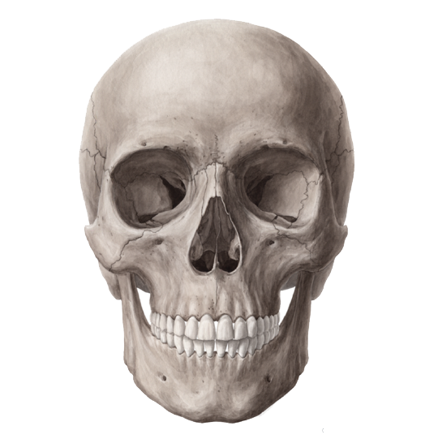
Decentralized Networks of
DEATH

Slide 4






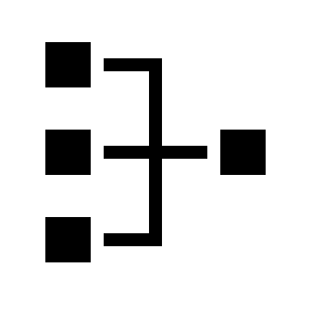





Slide 5
Test slide
New New

Slide 6











The Banality of Evil

Slide 7

The Banality of Evil

Slide 8




Satoshi Nakamoto

Slide 9
Distributed Volition
Once
upon
a
time
the
world
was
round
and
you
could
go
on
it
around
and
around
.
Once
upon
a
time
the
world
was
round
and
you
could
go
on
it
around
and
around
.
Once
upon
a
time
the
world
was
round
and
you
could
go
on
it
around
and
around
.
do
what
thou
wilt

Slide 11
I trust your trust You trust my trust We trust our trust They trust our trust We trust their trust We trust trust Trust trusts trust Trust trusts my trust Trust trusts your trust Trust trusts our trust Trust trusts their trust I trust your trust You trust my trust We trust our trust They trust our trust We trust their trust We trust trust. Trust trusts trust Trust trusts my trust Trust trusts your trust. Trust trusts our trust Trust trusts their trust I trust your trust You trust my trust We trust our trust They trust our trust We trust their trust We trust trust
Notes:
In a trustless decentralized system, the trust needs to start somewhere.

Slide 14
work
work
work
work
work
work
work
work
work
work
work
work
work
work
work
work
work
work
work
work
work
work
work
work
work
work
work
work
work
work
work

Slide 15
netWork Node CORE ConCEPT
poesis
consensual
hallucination
economy
collaborative

Slide 16
Evil contracts automate transacting evil for infinity

Slide 17
art
surveil
credit
Execute
war

